Slide 1
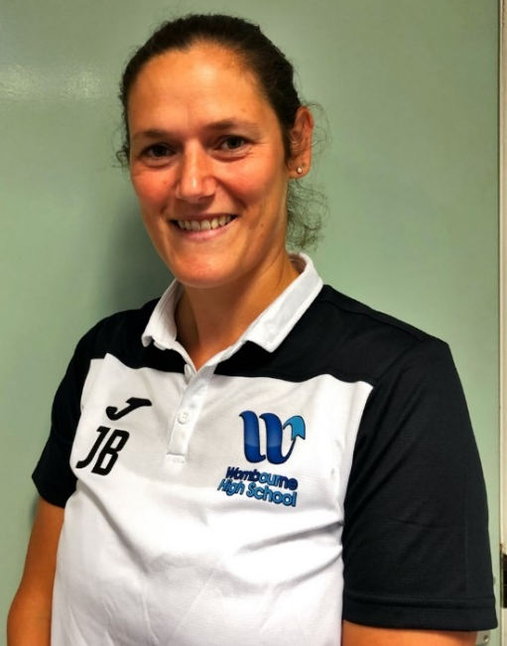
Hello Year 6, hope you’re all ok and looking forward to joining us in Year 7!
Being as we are not able to meet with you before September we would love to find out a little bit about your sporting background – some of you might love sport and take part in lots of different types whilst others may not like it as much (don’t worry – that’s ok!!)
We would like you to create a sporting profile about you. I’ve asked all my team to create their own profiles so you can learn a bit more about us as well ☺
See you all soon, Mrs Brotherton and the PE team
Induction Challenge
Include sporty pics of you if you want to ☺
What would you like to do in PE in Y7?
What sports do you do outside of school?
What things did you do at primary school?
Do you like Pe? Why or why not?

Slide 2
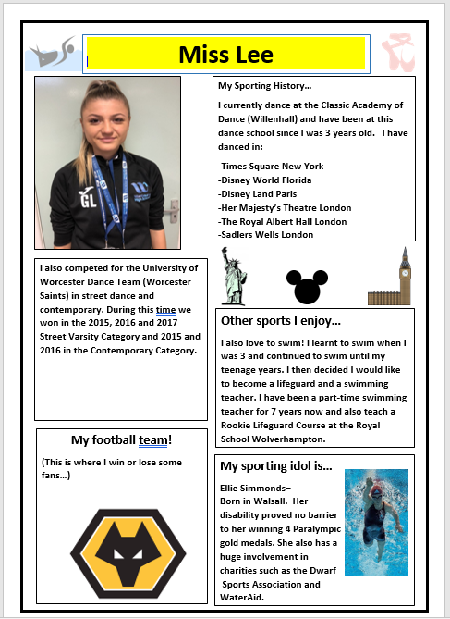

Slide 3
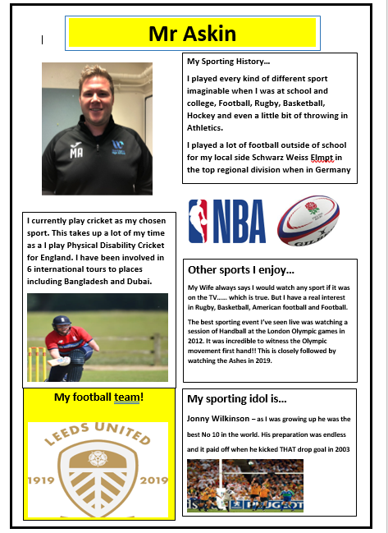
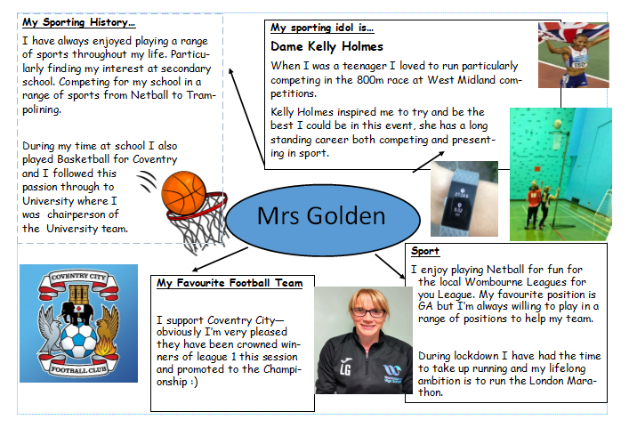

Slide 4
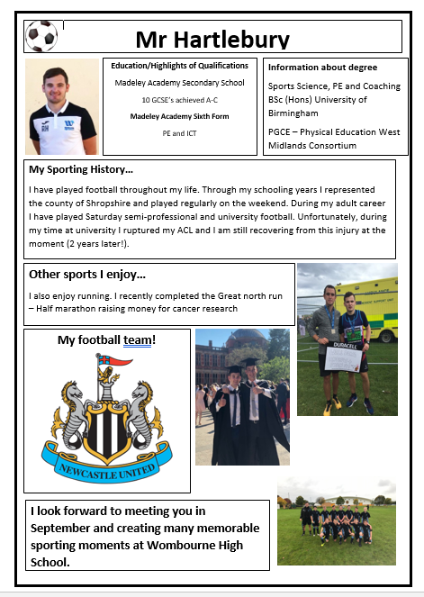
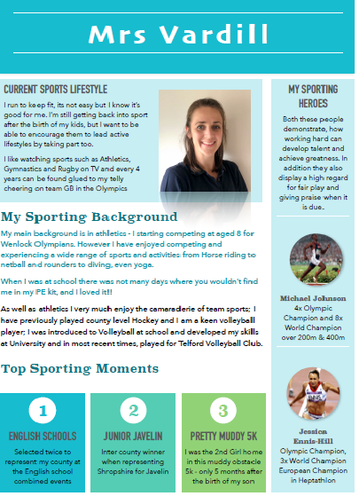

Slide 5
Frequently Asked Questions…
Do I need to buy all the PE kit?
You will need the t-shirt, shorts / skort, socks and non-black sports trainers as part of compulsory kit. You will also need suitable swim wear (a 1 piece costume / shorts) but these can be any colour. The jumper and joggers are recommended for colder weather but not essential.
Are after school clubs free?
Yes absolutely and students can join as many as possible.
My child can’t swim
Don’t worry we will fully support your child and help them to get water confident either through class lessons or additional opportunities after school in smaller group settings
How many lessons of PE will my child get?
All students will get 2 lessons a week

Slide 6
Frequently Asked Questions…
Do boys need football boots and shin pads?
It would be great if you could equip your child with a pair of boots and some shin pads as these are needed for the football and / or rugby units of work
Do students have to carry their PE kit all day?
No, you can get a locker which is arranged through reception to keep your kit in
What sports will my child cover?
Your child will cover a vast range of sports over their five years, some that may have been done at primary school and then new ones as well
What teams can my child join?
We have lots of different clubs and teams that you are able to join right across the year. Timetables are published each half term and shared with students in school but you can also follow us on Instagram and Facebook to get the up to date information at home
What if my child has any medical needs?
Please don’t worry, just send any relevant information in a note to your child’s PE teacher and we will make sure they are catered for

Slide 7
Top Tips!
Don’t forget to follow us on social media.
Keep active don’t forget try to get in a hour of physical activity a day
Always put your name on the inside of your PE kit too.
Buy a locker, so you don’t have to carry your kit round.
Join a new club, inside or outside of school . It’s a great way to make friends.
Get a comfortable bag, to keep and transport your PE kit in.
Don’t forget to get your ears pierced at the start of the summer so you can take them out for PE in September.
Encourage students to take responsibility for their kits! We have around 15 lost kits a week.
Talk to your teachers about your sporting successes– we don’t bite!!

