Slide 1


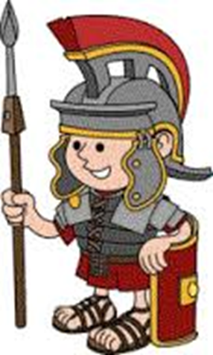
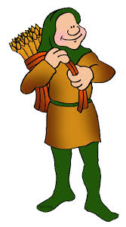
History is the study of the past. The study of history helps make sense of humankind. It also helps people understand the things that happen today and that may happen in the future. People trained in history are called historians. In preparation for your move to Wombourne High School we have prepared some tasks that will give you an idea of the type of History that you will study in Year 7 and the types of tasks that you will complete. Your task is to choose a topic below and complete the research, apply and create task.
 | Research… | Apply… | Create…
Who are the British? | Make a timeline to show how the people of Britain have changed over time. You should: Research the earliest people in Britain. Begin your timeline back in 800,000 BC and finish in the present day. Refer to at least the following people and what they brought to Britain: Hunter Gatherers Romans Anglo-Saxons Normans Jewish migrants in the middle ages. African migrants from the 1500-1700’s Migrants from the Commonwealth. | Using your research on how the people of Britain have changed over time create a poster that demonstrates what it means to be British. You should make sure that you refer to the wide range of contributions that migrant groups have given to Britain to make it the country that it is today. | TIME CAPSULE Create a time capsule that would show people in the future what it is like to live in Britain in 2020. You could fill the capsule with newspaper cuttings, pictures, photographs – anything that helps to show what 21st Century Britain is like.
What did the Romans do for us? | Make a timeline to show the Roman invasion, conquest and rule of Roman Britain. You should: Research the Roman invasion of Britain from Julius Caesar’s failed invasion in 55BC. Finish your timeline when the Romans left Britain in approx. 410AD. Refer to at least the following events: The invasion of Claudius The rebellion of Caratacus The rebellion of Boudicca The building of Hadrian’s Wall | Using your research from the timeline along with any more that you wish to complete, make a Facebook profile for Julius Caesar. You should include: personal information about his birthday, family, place of birth. Information on his achievements Messages from his friends (and perhaps some of those who weren’t his friend!) | HORRIBLE HISTORIES Create a story in the style of a Horrible Histories story connected to Roman Britain. You may want to talk about the invasion? Treatment of rebels? Living conditions? Anything that you find interesting.
Life in the Middle Ages | Make a timeline outlining what happened in the middle ages in Britain. You should: Research the middle ages (also known as the medieval period). Begin your timeline in approx. 1066AD and end it approx. 1500AD. Refer to some of the big events that took place during this time period e.g. The Battle of Hastings The Black Death The Peasants Revolt | Using your research from the timeline as well as any other research that you wish to do make a mind map showing what life was like in the middle ages. You should include information on at least: Homes Jobs Food | COME DINE WITH ME Imagine that you are living in the middle ages and are hosting a dinner party. Design a menu that you would serve that is authentic to the time period. You should also consider any entertainment that you may like to host during this dinner party.

